Slide 1
Lead Scoring Case Study using logistic regression
By: Satya Ranjan, Srushti Keskar, Swapnil Kapoor

Slide 2
Problem statement
X Education offers online courses to industry professionals and generates many leads through websites and search engines. However, its lead conversion rate is low, around 30%. To improve this, the company wants to identify "Hot Leads" with a higher potential to convert. By focusing on these leads, the sales team can increase conversion efficiency. The company aims to develop a model that assigns a lead score to each lead, prioritizing those with higher scores for better conversion chances, with a target conversion rate of 80%.

Slide 3
Business Goal
Model Development and Purpose
Identification of Hot Leads
Challenge 3
The company seeks to build a model that assigns a lead score to each lead, indicating its potential for conversion. Higher lead scores signify higher chances of conversion. The goal is to achieve an 80%+ conversion rate.
X Education aims to identify the most promising or "hot" leads. A model will be developed to assist in recognizing these leads, with an emphasis on deployment for future use.
X needs a model that assigns a score from 0 to 100 to each lead that helps identifying hot leads and improve conversion rates. The model should also be adaptable to peak time actions and optimal resource allocation.

Slide 4
Business Goal
Flexibility for Future Constraints
Logistic Regression Approach
The model must not only predict lead conversion but also handle future constraints like peak times, manpower and adjustments after achieving targets. These aspects should be incorporated into the model to meet future requirements.
A logistic regression model will be used. The model should also be flexible enough to adjust to changing company needs. These adjustments should be documented and included in the final presentation with recommendations.

Slide 5
Analysis Strategy
Importing and inspecting the data
Data Cleaning and Preparation
Exploratory data analysis
Correlation
Model Building and Evaluation
Prediction on the test set
Precision Recall-Review curve
Observations
Conclusion

Slide 6
Importing and
Inspecting the data

Slide 7
Importing and inspecting the data
Once the data is imported in the pandas dataframe, we get to see that the data comprises 9240 rows spread across 37 columns.
Out of these 37 columns there are only 7 columns with numerical values. Rest of the columns are of categorical type.

Slide 8
Data Cleaning and Preparation

Slide 9
Data Cleaning and Preparation
While checking for the null values in the data it seems there are quite a few columns containing null values
We dropped the columns with more than 30% missing or null values which brought down the number of columns to 31
Some of the categorical columns had a single value and the count of that value is equal to the number of row, which means all the users have selected the same option so keep these is also not relevant. So, dropped these columns too.
Now we are left with 26 columns for analysis shown below
There are some columns with Select as one of the values, we replace that with Unknown
Now the data looks ready for analysis

Slide 10
Exploratory data analysis

Slide 11
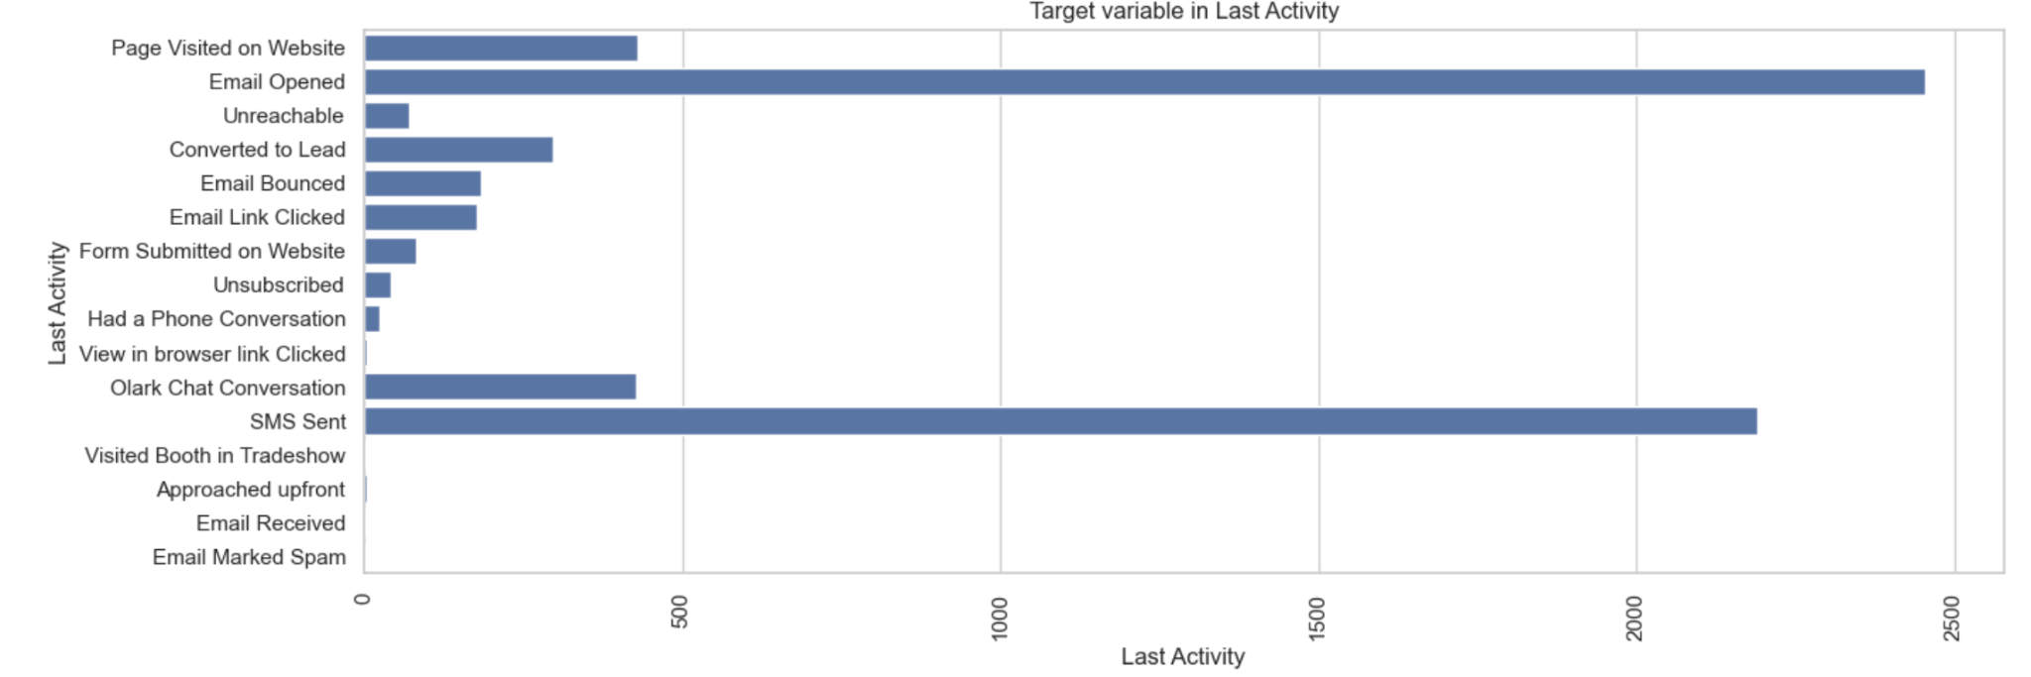
Exploratory data analysis: Highlights from Bi-Variate Analysis
Most leads respond to emails as shown by the last activity data

Slide 12
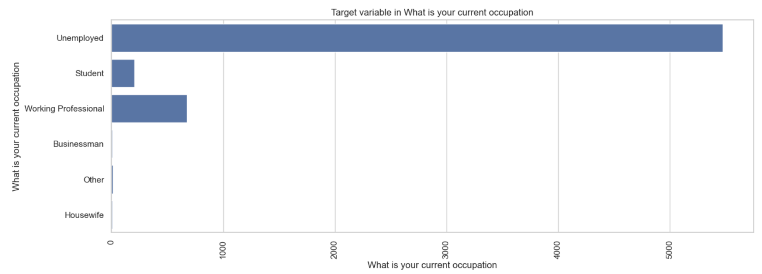
Exploratory data analysis: Highlights from Bi-Variate Analysis
Unemployed people are most interested in taking the course

Slide 13
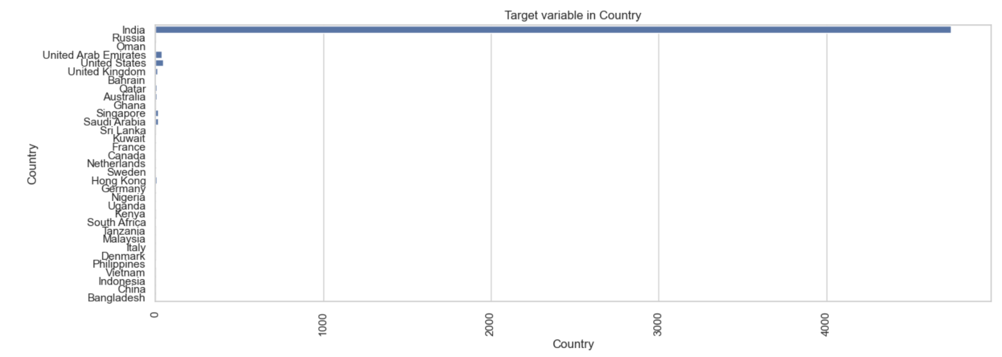
Exploratory data analysis: Highlights from Bi-Variate Analysis
Almost all the leads are from India

Slide 14
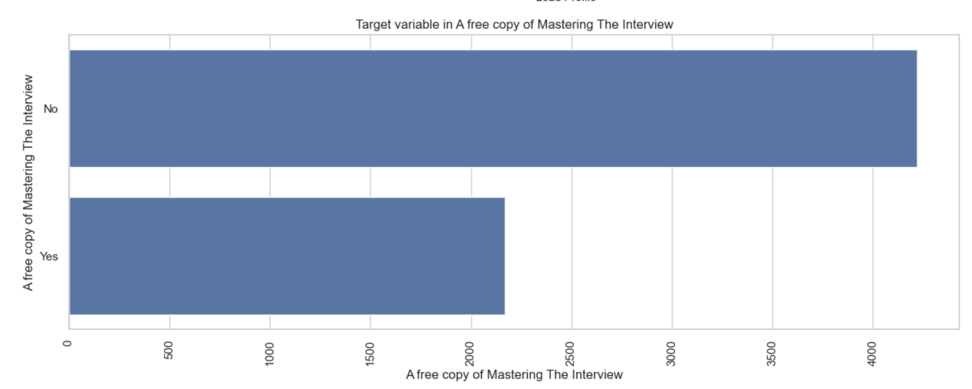
Exploratory data analysis: Highlights from Bi-Variate Analysis
Higher number of people did not opt for a free copy of interview prep book

Slide 15
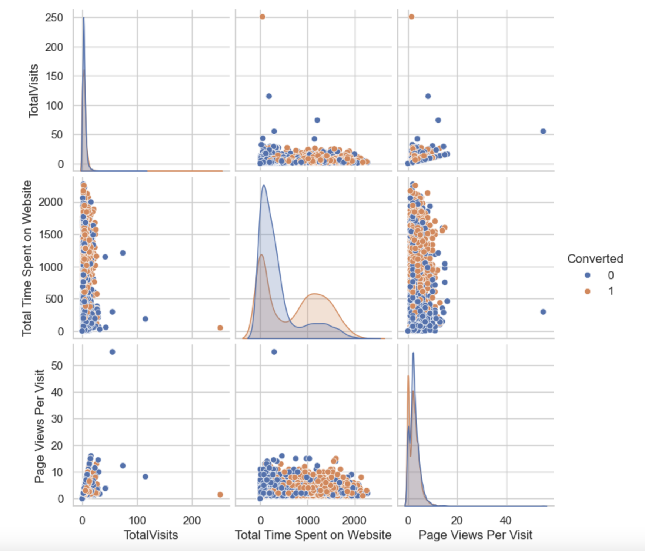
Exploratory data analysis: Highlights from Bi-Variate Analysis
Below graph shows that the more time people spend on the website and the more pages they visit, the higher their rate of conversion is.

Slide 16
Correlation

Slide 17
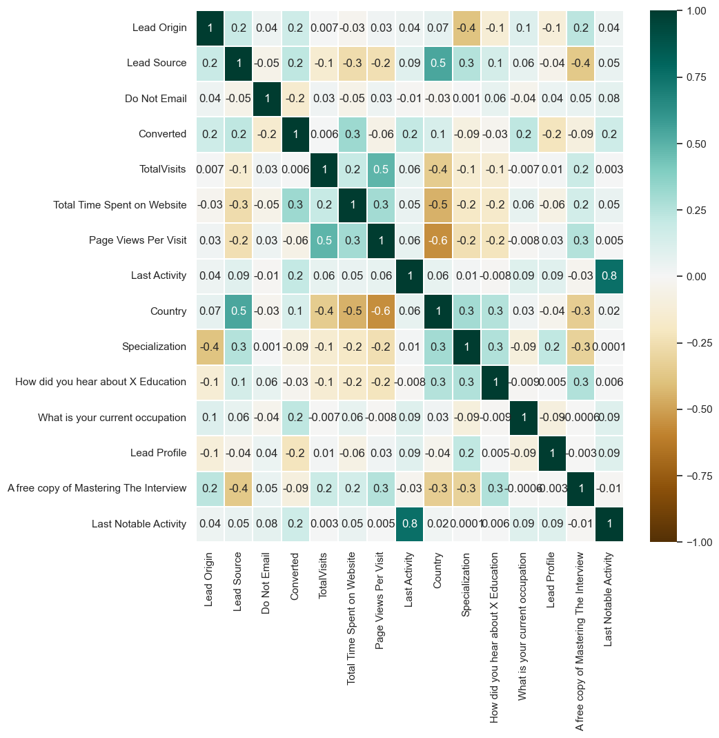
Correlation
The heat map shows the correlation between the variables with the target variable

Slide 18
Model building and
Evaluation

Slide 19
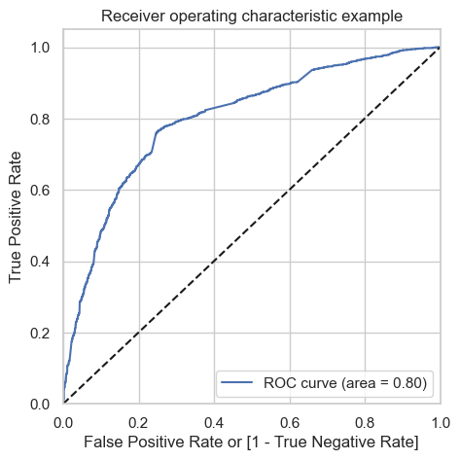
Model building and Evaluation
We created 3 models with this data. With the use of Model 1 and 2 we dropped columns with the highest VIF values. Dropped 'What is your current occupation' after Model-1 and ‘Lead Profile’ after Model-2
By Model-3 we had decent VIF and p-values so we used this model for evaluation
The ROCE curve from model 3 shows a good area, which is 0.8, under the curve

Slide 20
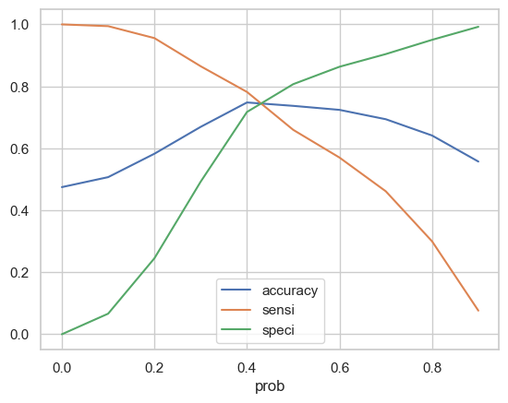
Model building and Evaluation
Using the confusion matrix we identified that 0.43 is the perfect point for cutoff. The plot below shows
This helped in identifying the Sensitivity and Specificity as 0.7631826741996234 and 0.7484035759897829 respectively with 0.7554214173932484 as accuracy

Slide 21
Prediction on the test set

Slide 22
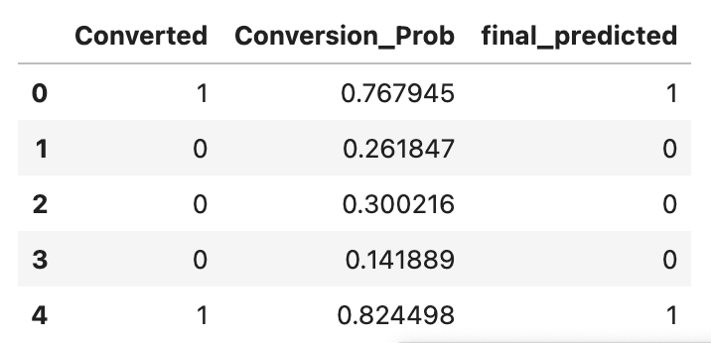
Prediction on the test set
Using the model, the predictions made were correct when tested on the test set
The accuracy, sensitivity and specificity score were 0.7450469238790407, 0.7598299681190224 and 0.7308085977482088 respectively.

Slide 23
Precision Recall-Review curve

Slide 24
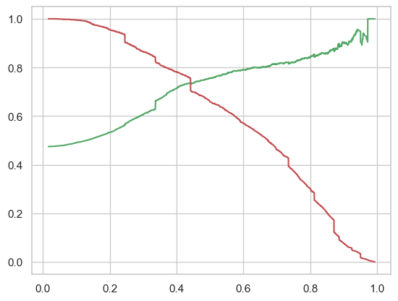
Precision Recall-Review curve

Slide 25
Observations

Slide 26
Observations
The accuracy of the test and train data matched perfectly
The accuracy, sensitivity and specificity scores for both, test and train data were as follows
Accuracy = 75% (0.7450469238790407)
Sensitivity = 76% (0.7598299681190224)
Specificity = 73% (0.7308085977482088)
The list of features selected for the final model for evaluation is below
Lead Origin
Lead Source
Do Not Email
Total Time Spent on Website
Page Views Per Visit
What is your current occupation
Lead Profile
Last Notable Activity

Slide 27
Conclusion

Slide 28
Observations
Lead conversions are highest from landing page submissions, Google redirects and direct traffic. While leads spending more time on the website and employed professionals have a higher probability of conversion
Time spent on the website, number of visits, source of lead (Google, Direct traffic, Organic search, Welingak website), and activities like SMS have turned out to be the key source of influencing leads
Data suggests the importance of website engagement and specific user segments. Targeted marketing efforts on these metrics will boost sales and conversion.
The logistic regression model accurately predicts lead conversions with 75% accuracy in both test and training data. So, this will prove to be a good model for predicting and boosting conversion and so the sales too.

